Slide 1
Group 9:
Layout thrashing
Group 9: Weigen Chen, Yihao Jia, Leon Lu

Slide 2
Problem Space
Definition: Layout thrashing occurs when the browser continuously re-renders the page layout as elements load or styles change dynamically.
Effect: Layout thrashing leads to longer rendering times or content flashing, deducing user experience (especially if users unintentionally click on the wrong elements due to it).
Annoying Ads

Slide 3
Learning Goal
Measure the impact in the wild
Explore the Remedies
Find a automatic way for web users
Find a automatic way for web developers

Slide 4
Deliverables
Analysis: popular websites
Browser plugin: for web users (attempted)
Optimization tricks: for web developers

Slide 5
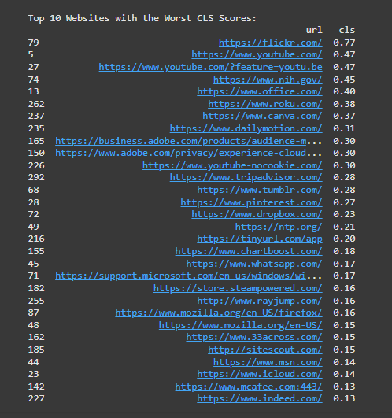
Site Score analysis
Analyzed 300 urls scores with Google PageSpeed Insights API
Real most recent chrome user data
API returns CLS, FCP, LCP scores
CLS（Cumulative Layout Shift） FCP（First Contentful Paint） LCP（Largest Contentful Paint）
Notes:
Because we want to conduct a comprehensive survey to investigate which metrics truly impact the visual performance of a webpage.

Slide 6
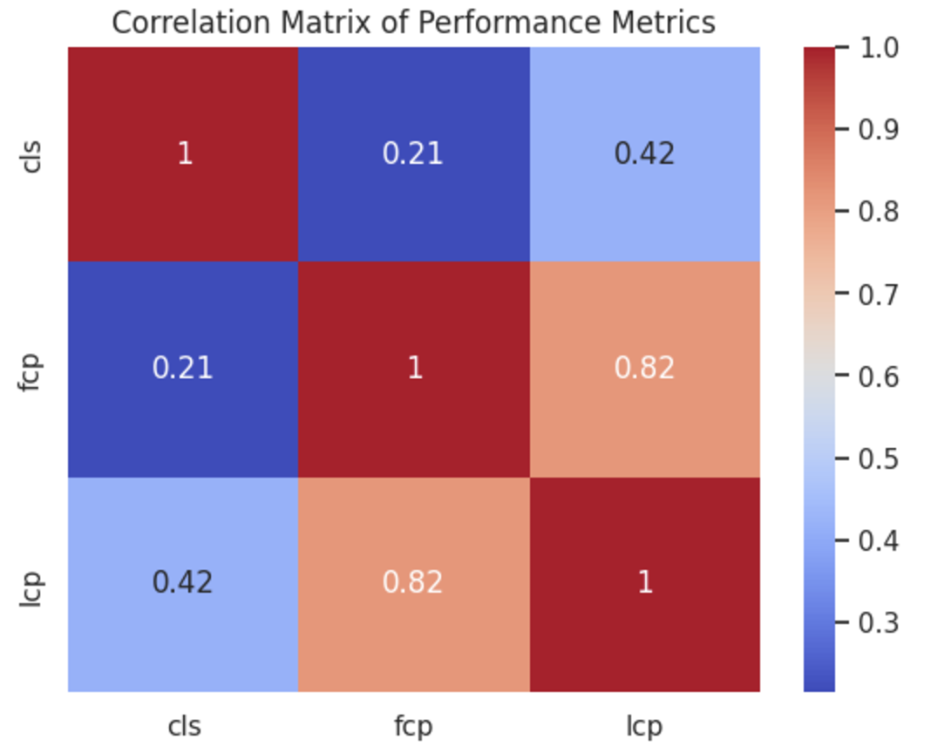
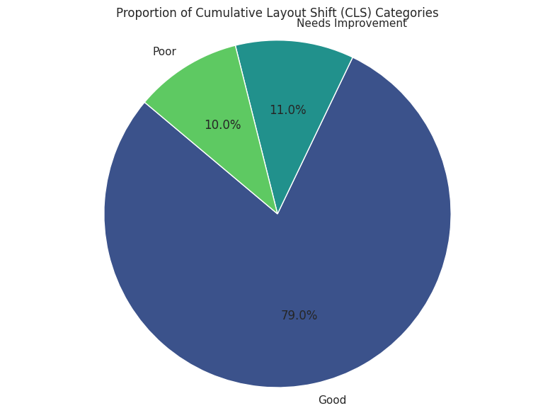
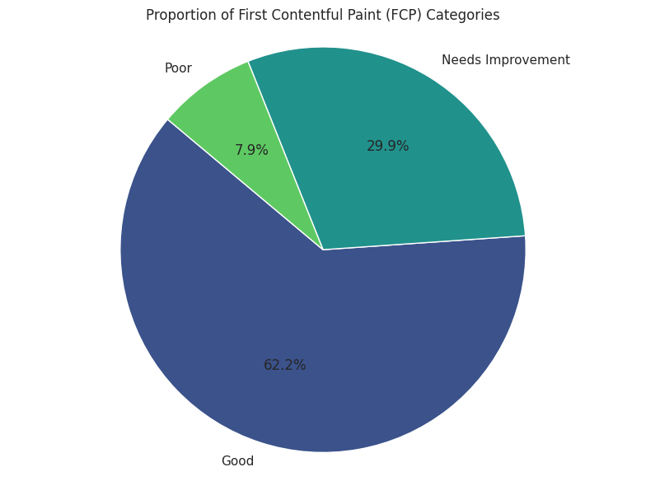
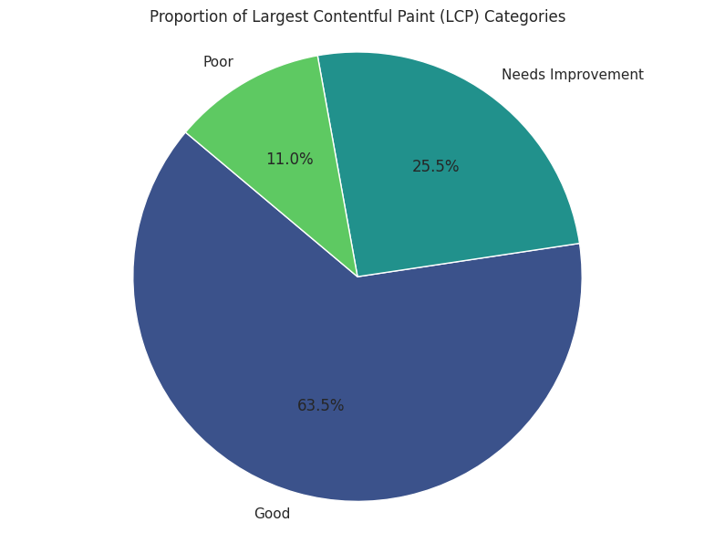
Site Score analysis
Lots of websites needs improvement
FCP, LCP not that closely related to CLS

Slide 7
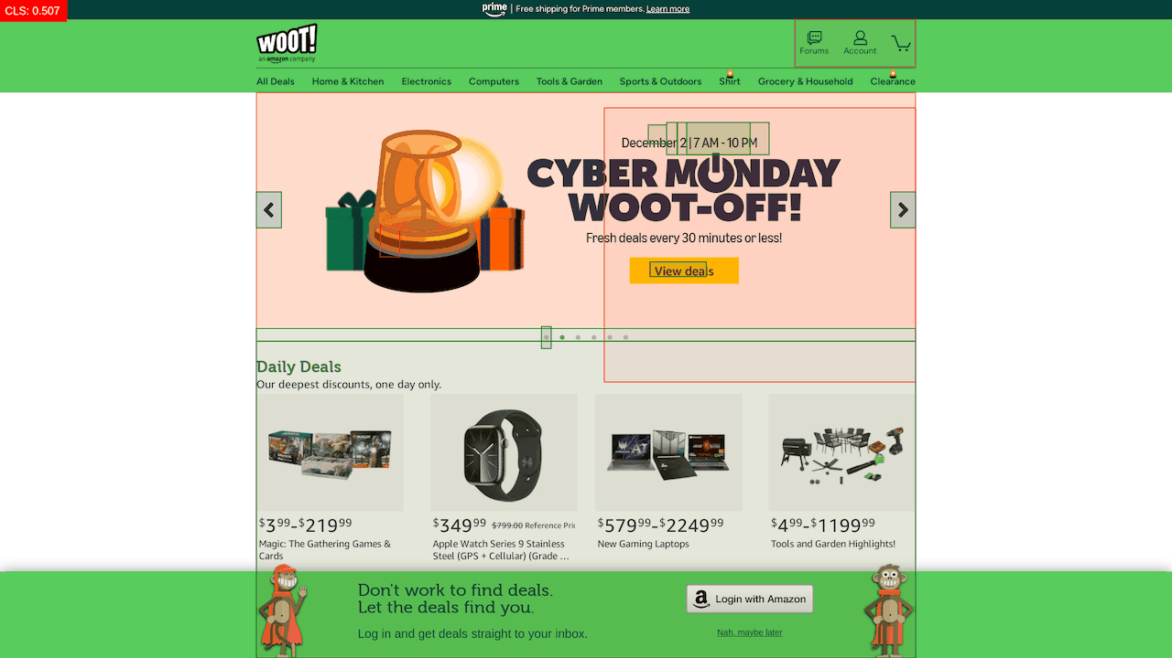
Qualitative Analysis
Worst websites analysis using Google Performance tab/Lighthouse report and Layout Shift GIF Generator
Lots of resource shifts due to delayed network
Images, Videos, Headers/Footers
Animations

Slide 8
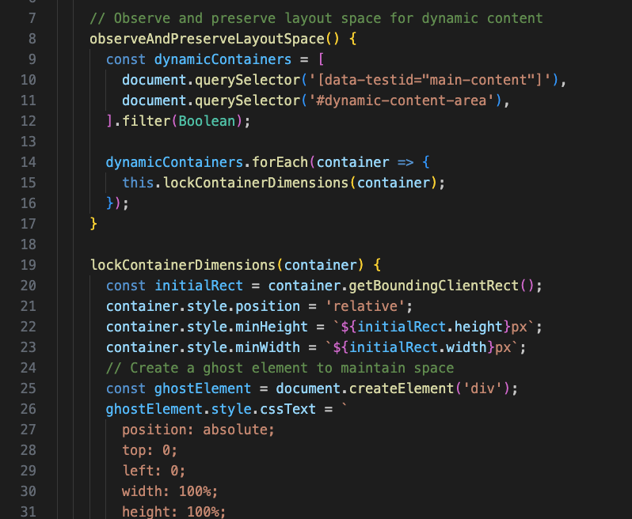
Browser plugin attempt
Reserve space for dynamic content
Intercept delayed network requests
But …
Not Realistic for general use
Every website has unique elements, frameworks, and technologies
CSP might block DOM manipulation
Better chance to collaborate with frameworks and libraries

Slide 9
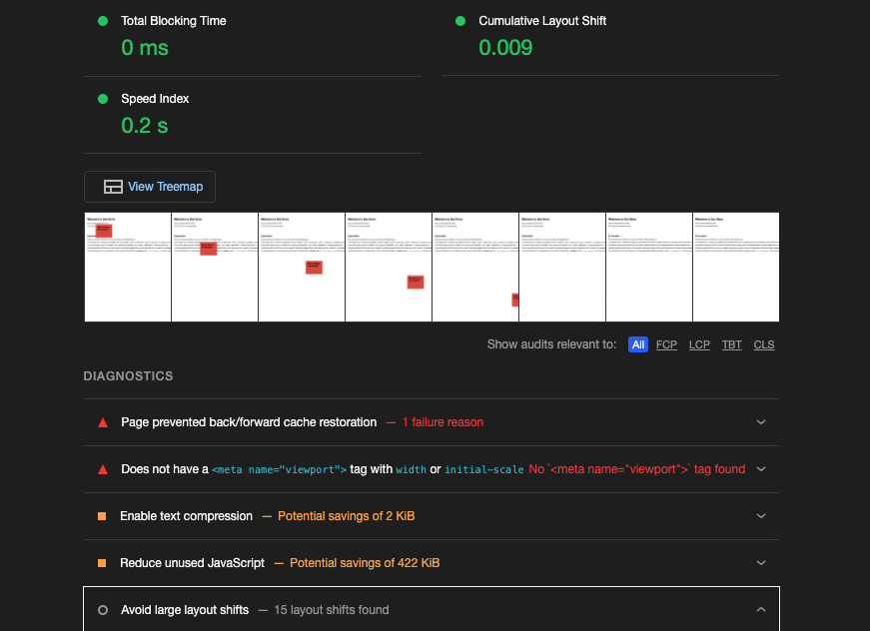
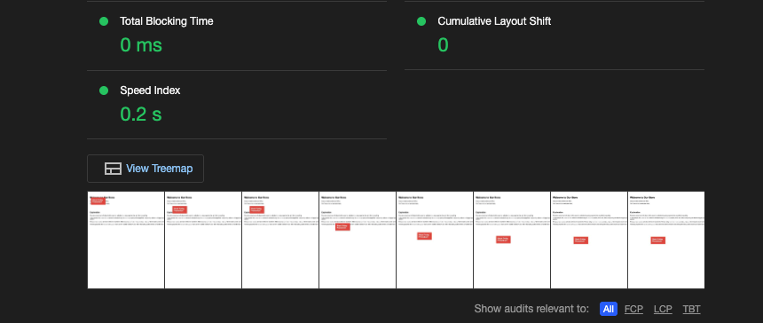
Layout Shift Demo - Animation
Before After
CSS animation with translate and transform
Instead of things like top: calc(90vh - 100px)

Slide 10
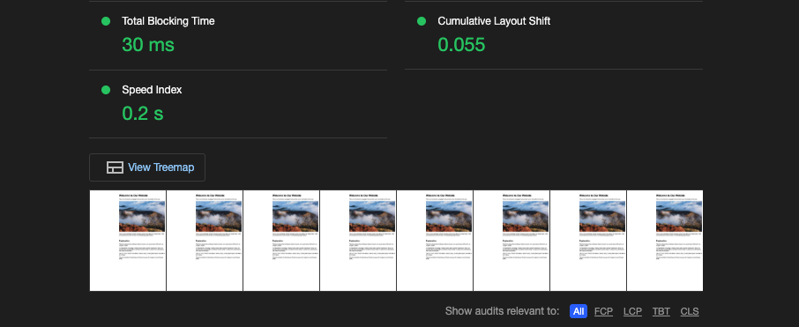
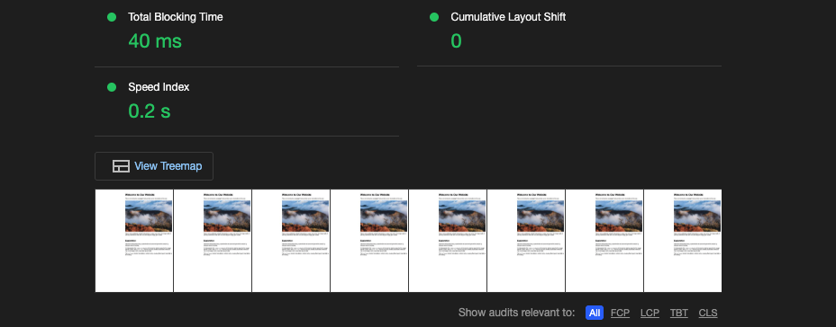
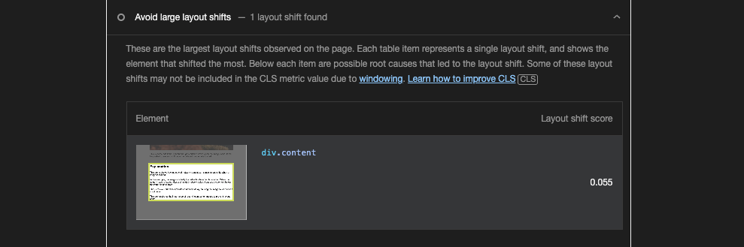
Layout Shift Demo - Delayed Network
Before After
Preserve space with element width and height, or aspect-ratio

Slide 11
Layout Shift Demo - Web Font
Web fonts enhance user experience but can contribute to layout shift.
Font Loading Behavior:
FOUT (Flash of Unstyled Text): The fallback font is shown until the web font loads and swaps in.
FOIT (Flash of Invisible Text): Text remains invisible until the web font is fully loaded.
Solutions
Preload the font from local path, this is because a lot web font is loaded by CDN
@font-face property
font-display: swap
Notes:
Reference:
https://web.dev/articles/optimize-cls#web-fonts
https://developers.google.com/fonts/docs/css2
https://web.dev/articles/font-best-practices

Slide 12
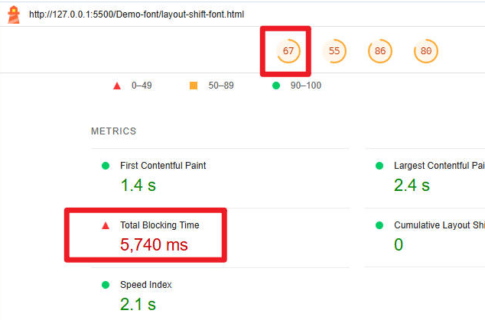
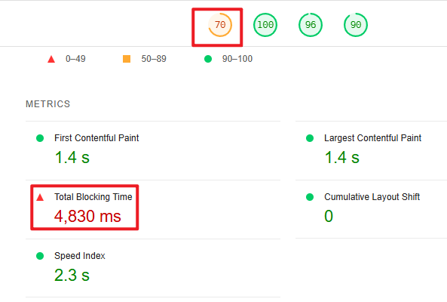
Layout Shift Demo - Web Font - Difference
Before After
font-display: swap + preload
Notes:
FOIT (Flash of Invisible Text): Text remains invisible until the web font is fully loaded
What’s more, iif the web font and default font have a huge difference on height or width, it will cause the layout thrashing

Slide 13
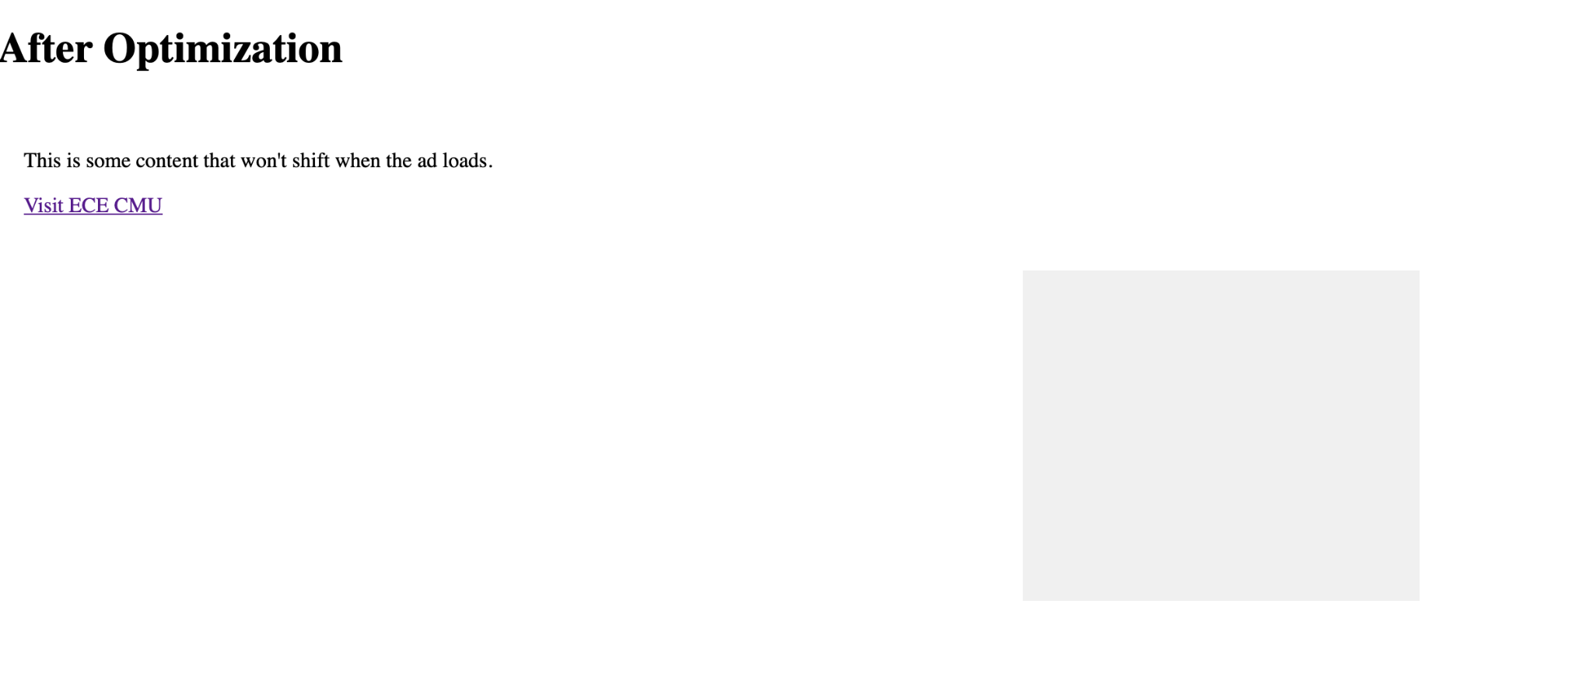
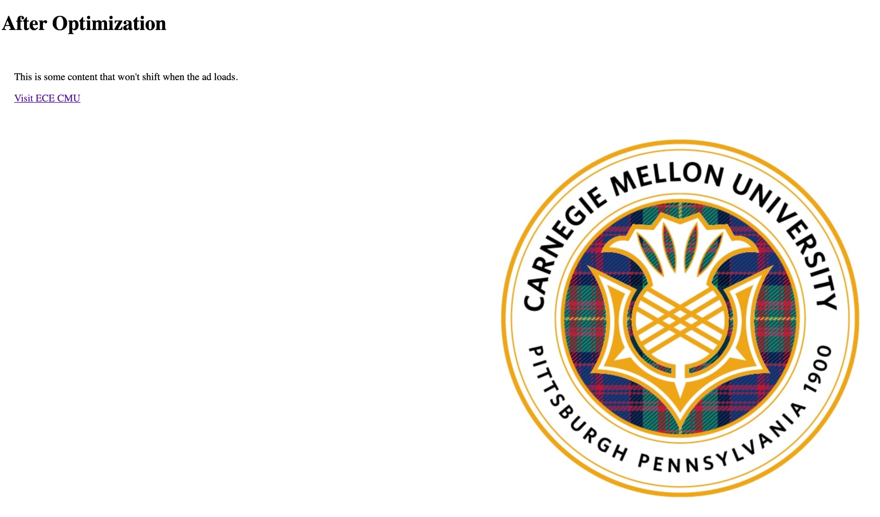

Layout Shift Demo - bfcache

Slide 14
Thank you!
12/04/2024

